Slide 1
Consulting Solution for GAAP Pilot
Group 7
Abhishek Alate,Yiwen Chen, Peipei Gao,
Xinyu Yan, Junzhe Yin
Notes:
Hello everyone, we are here to provide you our consulting solution for GAAP pilot.

Slide 2
GV should launch the GAAP pilot in Australia
Driven by:
Australia is the right market for precision agricultural hardware.
Launch in Australia will maximize profit.
First-mover advantage is achievable in Australia.
Notes:
Australia is the best market to launch our new GAAP pilot. This conclusion is mainly derived by three factors. Firstly, Australia is the right market for precision agricultural hardware, Secondly,Launch in Australia will maximize our profit. Lastly, we can gain huge early market entry advantage if we launch in Australia. Me and my peers will illustrate those points in the next few minutes.

Slide 3
Australia is the right market for precision agricultural hardware.
Launch in Australia will maximize profit.
First-mover advantage is achievable in Australia.
Notes:
let's start from the market analysis

Slide 4
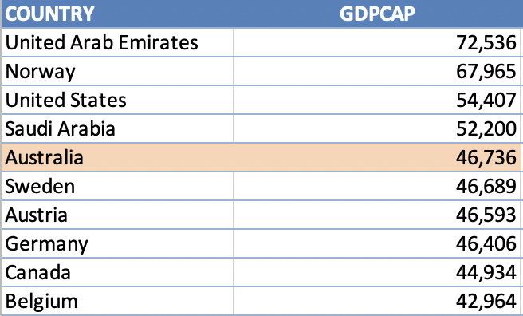
Australia is the right market for precision agricultural hardware
Drone regulation is favorable to precision agriculture in Australia.
Customer’s high ability to pay in Australia
Source:
https://www.casa.gov.au/drones
Notes:
The first thing we have looked into is the drone regulation in australia.
If you are flying drone for commercial purpose, you're usually required to hold a remote pilot licence (RePL). However, if the drone you're flying weighs less than 2 kg, you can fly under the 'Sub 2 kg' excluded category.
However, if you're only flying over your own land, you are also excluded from the requirement.
Based on this policy, we can further our target customer to small farm owner, who can simple purchase a drone and integrated into in the dairy farming procedure

Slide 5
Australia is the right market for precision agricultural hardware
Legal, Political, and Infrastructure
Human & Technology Infrastructure Support
Legal & Political
Legal:
Australia ranks the 4th in terms of getting credit.
Australia ranks the 6th in terms of enforcing contracts.
Political:
Australia’s investment climate is conducive to investment from the United States based on the Australia-US Free Trade Agreement (AUSFTA)
Cellular technology:
Australia is coming to 5G
Access to electricity:
100% of rural population have access to electricity.
High literacy rate:
Australia has a literacy rate of 90%.
Source: https://www.theguardian.com/technology/2019/jul/28/5g-in-australia-getting-up-to-speed-with-the-future-of-mobile
https://onlinelibrary-wiley-com.proxygw.wrlc.org/doi/epdf/10.1111/j.1467-8462.2012.00686.x
https://www.doingbusiness.org/en/rankings#

Slide 6
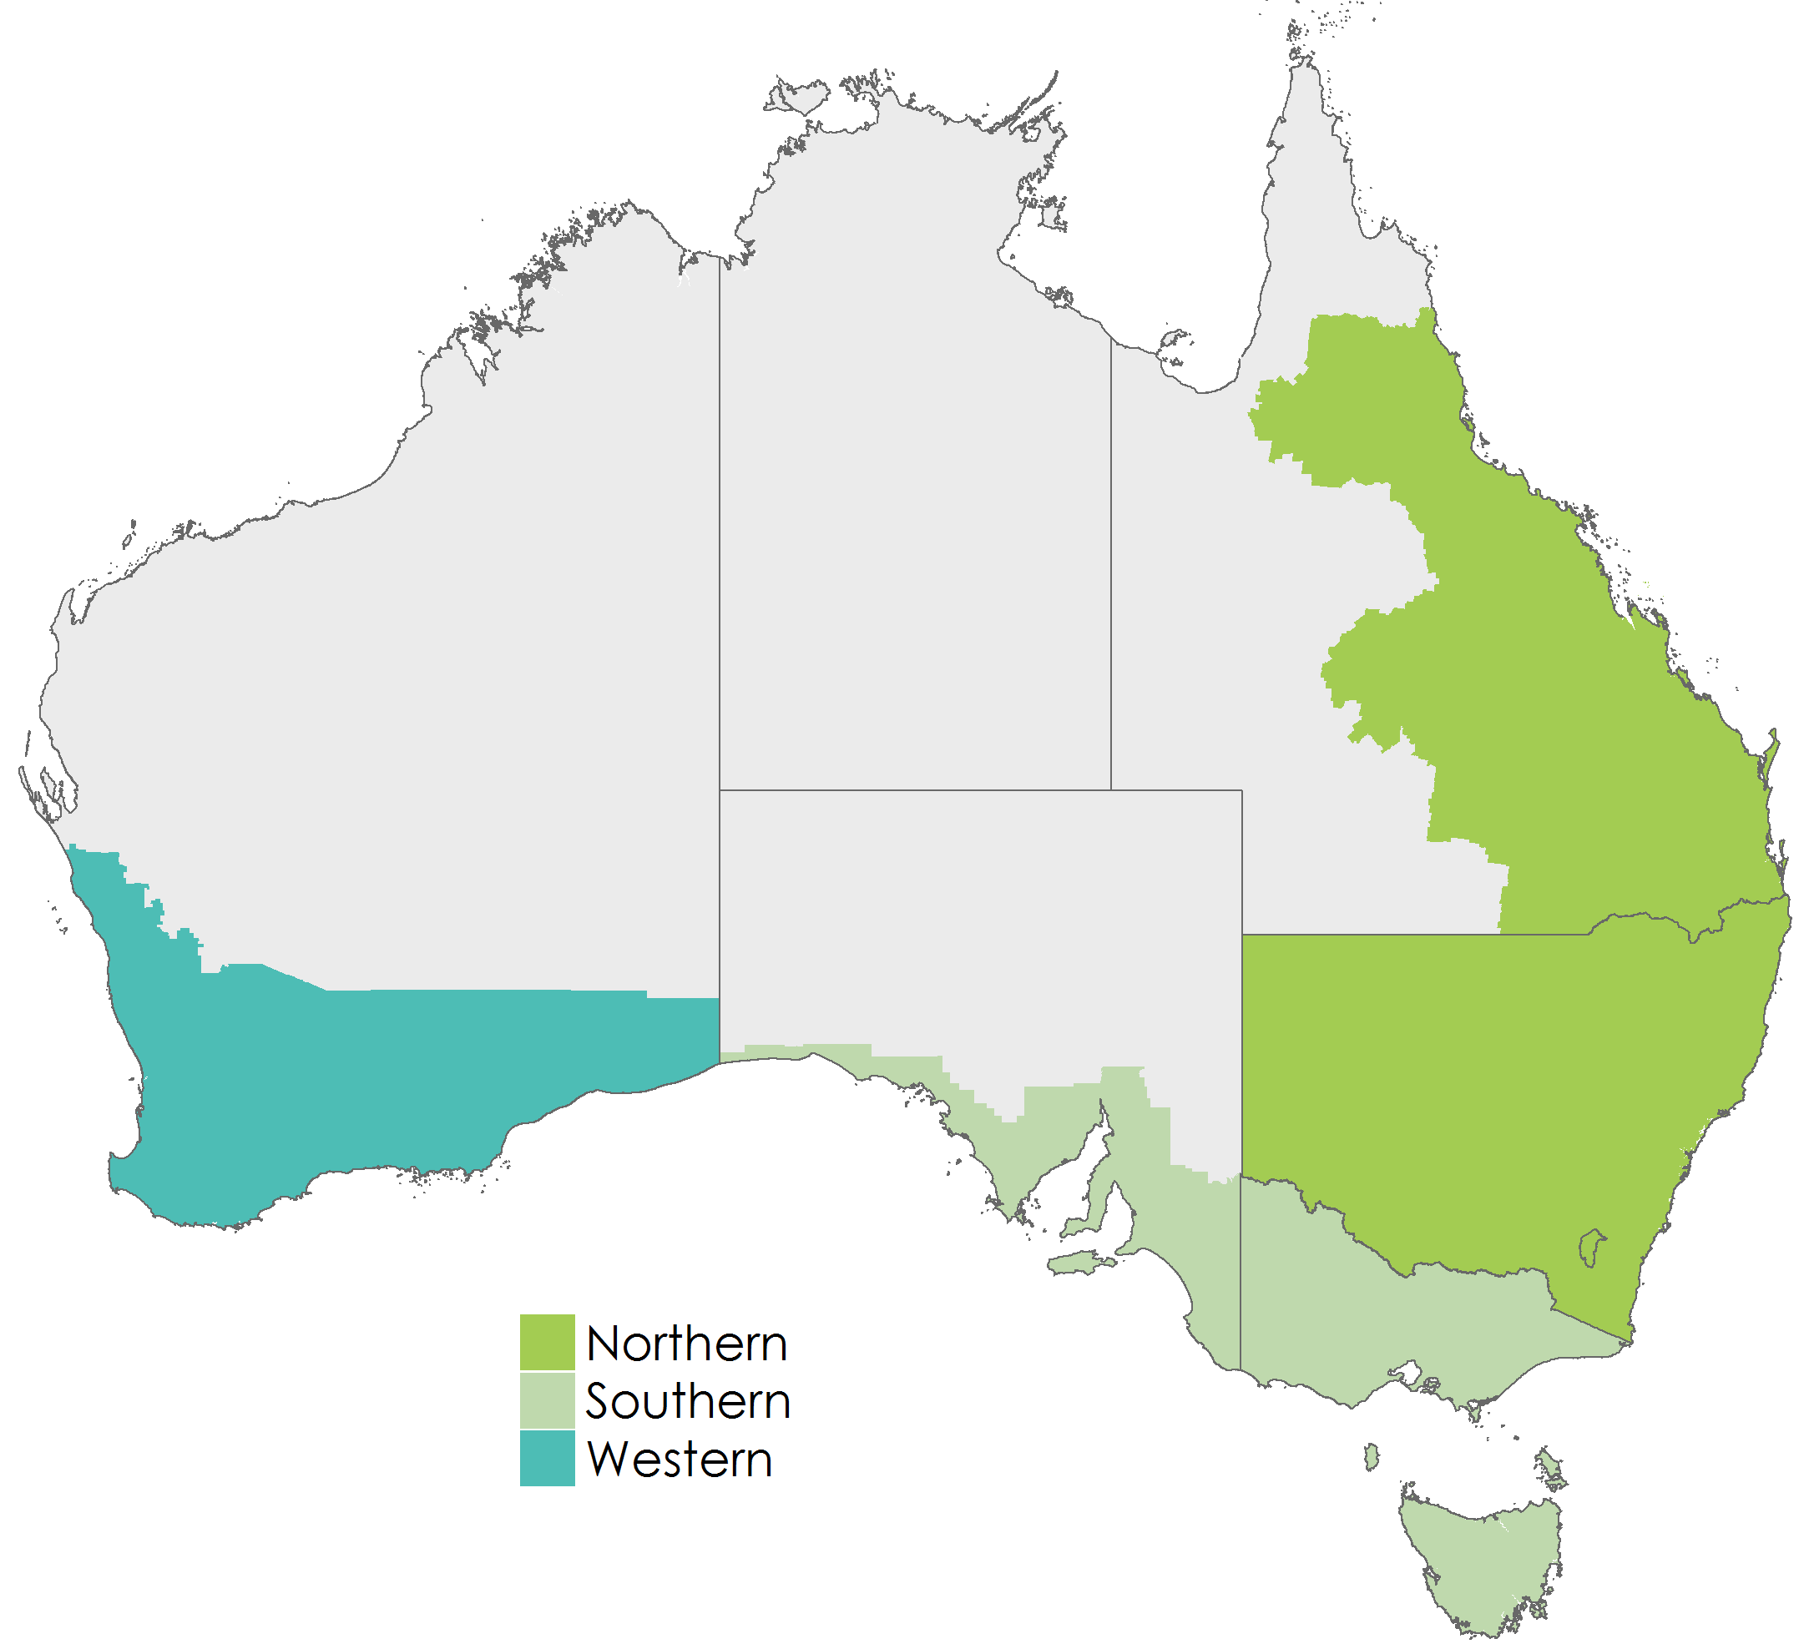
Australia is the right market for precision agricultural hardware
Geography of interest
Geography of interest (by priority):
Western region
Southern region
Northern region
Source: Grains Research and Development Corporation, Australia
Notes:
to start off, Australia is the right market for precision agricultural hardwares.
Theri drone regulation is favorable to precision agricultural. If you earn money by flying your drone, you're usually required to hold a remote pilot licence (RePL) or remotely piloted aircraft operator's certificate (ReOC). However, if the drone you're flying weighs less than 2 kg, you can fly under the 'Sub 2 kg' excluded category.
However, if you're only flying over your own land, you may be able to operate under the 'Flying over your own land' excluded category. Operations under this category could include:
aerial spotting
land surveying
weed and pest spraying
carrying cargo.

Slide 7
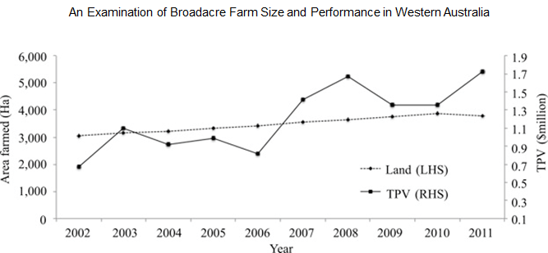
Australia is the right market for precision agricultural hardware
Growing farm size and rising farm production value
Source: An examination of broadacre farm size and performance in western australia, The Australian Economic Review
Notes:
to start off, Australia is the right market for precision agricultural hardwares.
Theri drone regulation is favorable to precision agricultural. If you earn money by flying your drone, you're usually required to hold a remote pilot licence (RePL) or remotely piloted aircraft operator's certificate (ReOC). However, if the drone you're flying weighs less than 2 kg, you can fly under the 'Sub 2 kg' excluded category.
However, if you're only flying over your own land, you may be able to operate under the 'Flying over your own land' excluded category. Operations under this category could include:
aerial spotting
land surveying
weed and pest spraying
carrying cargo.

Slide 8
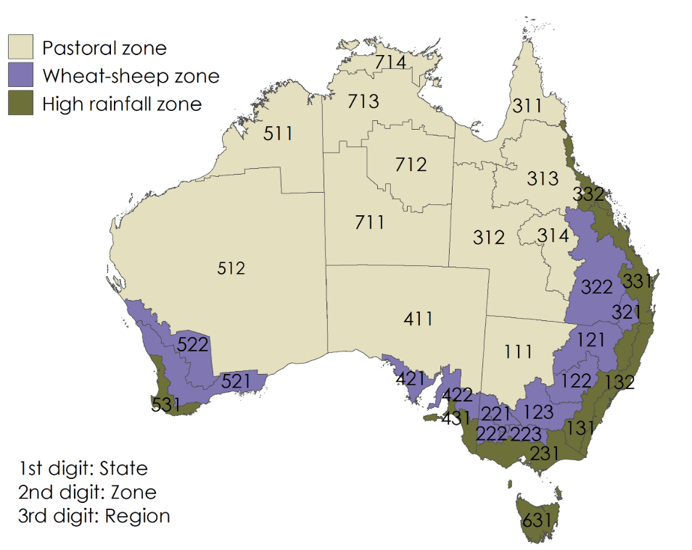
Australia is the right market for precision agricultural hardware
Launch zone
GAAP launch zones:
Zone 521 and 522
Source: Australian Bureau of Agricultural and Resource Economics
Notes:
to start off, Australia is the right market for precision agricultural hardwares.
Theri drone regulation is favorable to precision agricultural. If you earn money by flying your drone, you're usually required to hold a remote pilot licence (RePL) or remotely piloted aircraft operator's certificate (ReOC). However, if the drone you're flying weighs less than 2 kg, you can fly under the 'Sub 2 kg' excluded category.
However, if you're only flying over your own land, you may be able to operate under the 'Flying over your own land' excluded category. Operations under this category could include:
aerial spotting
land surveying
weed and pest spraying
carrying cargo.

Slide 9
Australia is the right market for precision agricultural hardware
Wheat as a target crop
Wheat has nutrient management issues
Wheat yields are high when water consumption is optimized
Both of these can be tackled using our technology.
Source:
Key crop nutrient management issues in the Western Australia grains industry: a review. Australian Journal of Soil Research
Effects of supplemental irrigation based on soil water content on water consumption, dry matter and yield of wheat. Chilean Journal of Agricultural Research
Notes:
to start off, Australia is the right market for precision agricultural hardwares.
Theri drone regulation is favorable to precision agricultural. If you earn money by flying your drone, you're usually required to hold a remote pilot licence (RePL) or remotely piloted aircraft operator's certificate (ReOC). However, if the drone you're flying weighs less than 2 kg, you can fly under the 'Sub 2 kg' excluded category.
However, if you're only flying over your own land, you may be able to operate under the 'Flying over your own land' excluded category. Operations under this category could include:
aerial spotting
land surveying
weed and pest spraying
carrying cargo.

Slide 10
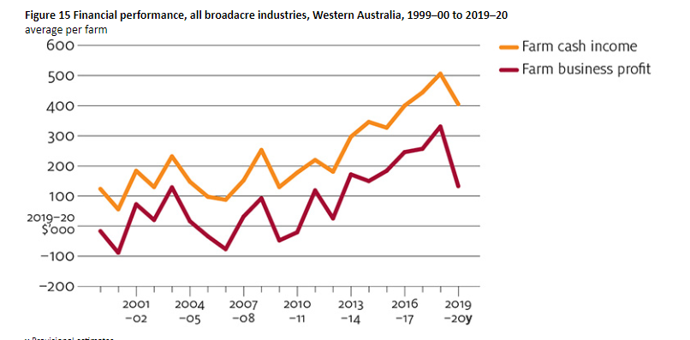
Australia is the right market for precision agricultural hardware
Wheat as a target crop
Source: ABARES Australian Agricultural and Grazing Industries Survey
Notes:
to start off, Australia is the right market for precision agricultural hardwares.
Theri drone regulation is favorable to precision agricultural. If you earn money by flying your drone, you're usually required to hold a remote pilot licence (RePL) or remotely piloted aircraft operator's certificate (ReOC). However, if the drone you're flying weighs less than 2 kg, you can fly under the 'Sub 2 kg' excluded category.
However, if you're only flying over your own land, you may be able to operate under the 'Flying over your own land' excluded category. Operations under this category could include:
aerial spotting
land surveying
weed and pest spraying
carrying cargo.

Slide 11
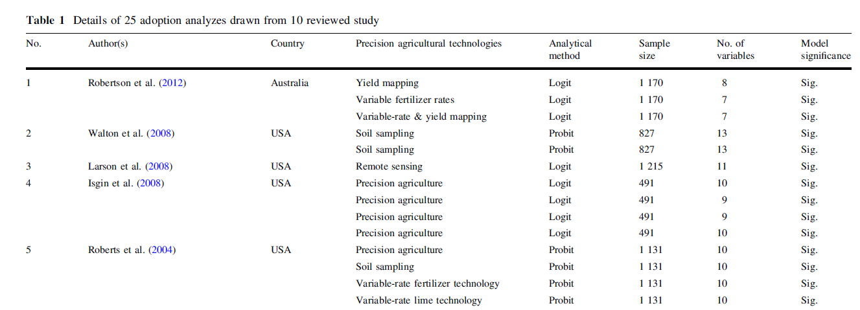
Australia is the right market for precision agricultural hardware
Precision agriculture technology adoption
Source: Factors influencing the adoption of precision agricultural technologies: A review for policy implications, Precision Agriculture
Notes:
to start off, Australia is the right market for precision agricultural hardwares.
Theri drone regulation is favorable to precision agricultural. If you earn money by flying your drone, you're usually required to hold a remote pilot licence (RePL) or remotely piloted aircraft operator's certificate (ReOC). However, if the drone you're flying weighs less than 2 kg, you can fly under the 'Sub 2 kg' excluded category.
However, if you're only flying over your own land, you may be able to operate under the 'Flying over your own land' excluded category. Operations under this category could include:
aerial spotting
land surveying
weed and pest spraying
carrying cargo.

Slide 12
Australia is the right market for precision agricultural hardware
Launch in Australia will maximize profit
First-mover advantage is achievable in Australia

Slide 13
Launch in Australia will maximize profit
Profit
Revenue
Cost
We can effectively reduce shipping cost.
Volume
Price
Australia has the highest Partner Performance Index.
Set our product price properly to maximize our profit

Slide 14
Launch in Australia will maximize profit
Australia has a large market size:
Australia has the highest Partner Performance Index based on our prediction model.
Set price properly:
Unit price range: $2000-$5000 (depends on the different level of the product)*
Pricing method: Value-based pricing
Reduce shipping cost:
Improve accuracy to avoid additional fees for re-delivery or full refund.
Australia has a excellent geographical location and the extensive distribution of ports and airports.
Source: Best Drones For Agriculture 2020: The Ultimate Buyer’s Guide https://bestdroneforthejob.com/drone-buying-guides/agriculture-drone-buyers-guide/

Slide 15
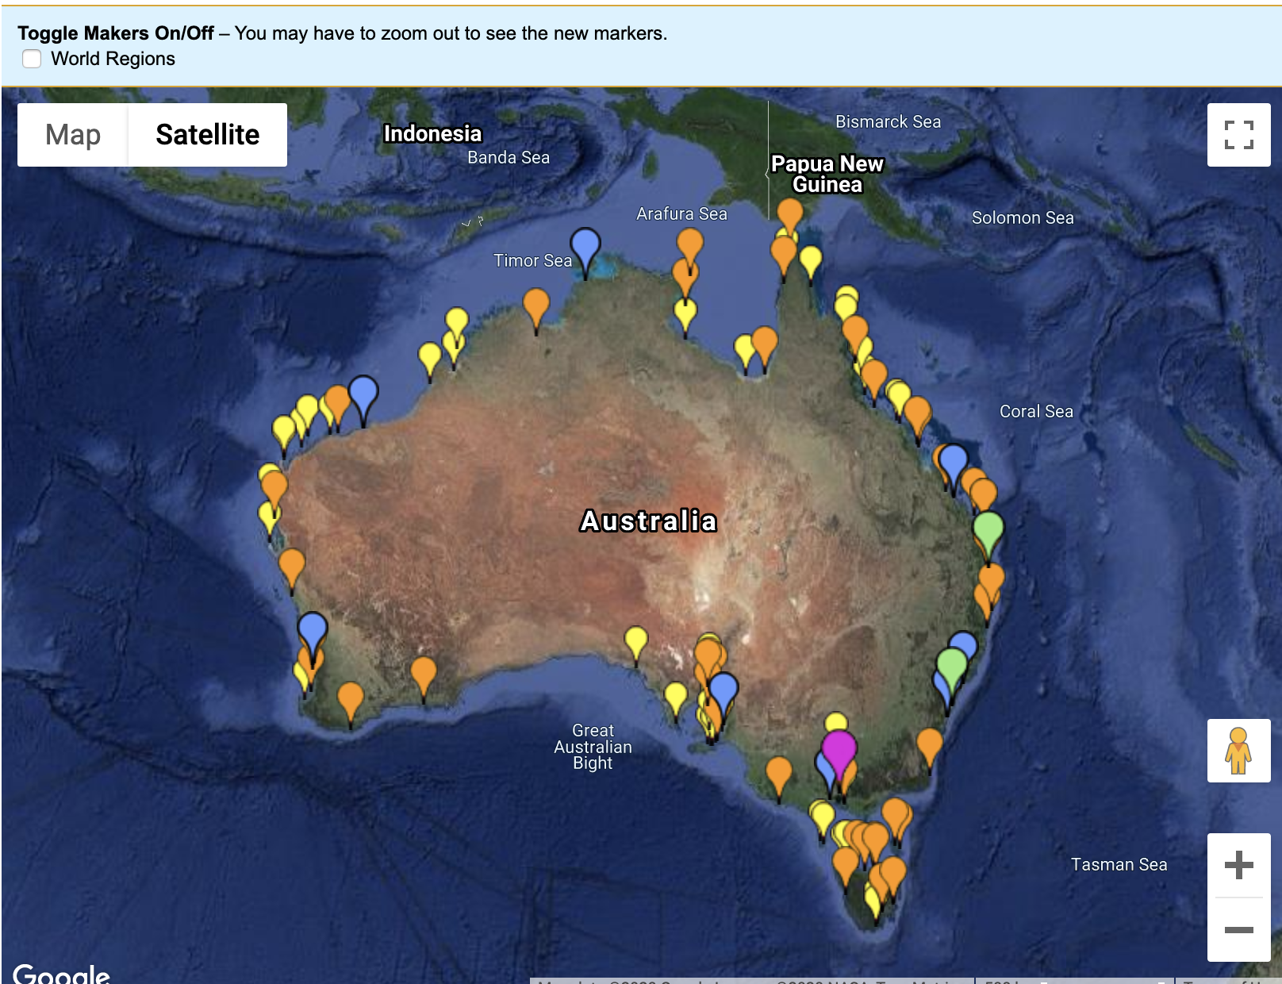
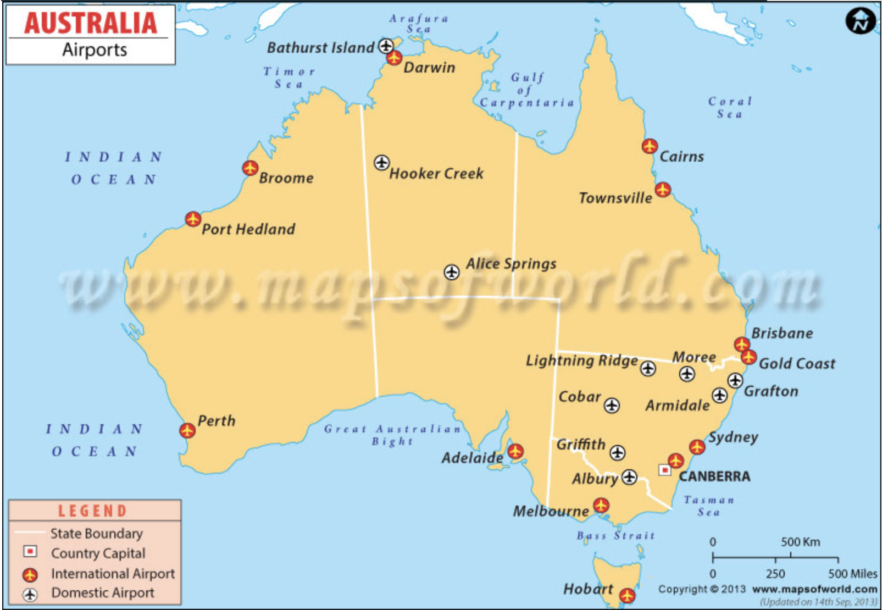
Launch in Australia will maximize profit
Ports in Australia
Airports in Australia
Source: Maps of world.
https://www.mapsofworld.com/

Slide 16
Australia is the right market for precision agricultural hardware
Launch in Australia will maximize profit
First-mover advantage is achievable in Australia

Slide 17
First-mover advantage is achievable in Australia
Implementation Timeline
Cross-department collaboration
Work with the General Counsel on import permits.
Work with the Finance team to set price and budget.
Work with the Marketing and Sales departments to develop marketing plans and set sales goals.
Execute plans
Execute the adjusted strategy/marketing plan to increase sales and reduce costs to achieve the fundamental goal of maximizing profit
June 2020
2023 - 2025
March 2020
September 2020
Enter the market
Value diminishes
As we do not plan to invest in R&D and improve this technology, its value will diminish within 3 to 5 years.
Export the product.
Execute Marketing plan and make adjustments as necessary.

Slide 18
GV should launch the GAAP pilot in Australia
Driven by:
Australia is the right market for precision agricultural hardware.
Launch in Australia will maximize profit.
First-mover advantage is achievable in Australia.
Notes:
To summarize, we recommend you to launch the GAAP pilot in Australia because first, it is the right market with favorable policies, infrastructure, and customer base.
Second, launch our precision agriculture in Australia will maximize our profit. And thirdly, we are able to earn early market advantage in Australia.

Slide 19
Appendix
Slide
Appendix
04 Why Australia
13 Profit Maximization
17 First-mover Advantage
20 Sales and Profits over Product Life Cycle
21 Case Background
22 Key Players
23 Research Bounds
24 Entry Modes Selection: Exporting
25 World Bank Doing Business Ranking
26 Risk and Mitigation
27 Global Potential Analysis
28 Sales and Profits over Product Life Cycle
29 Citation

Slide 20
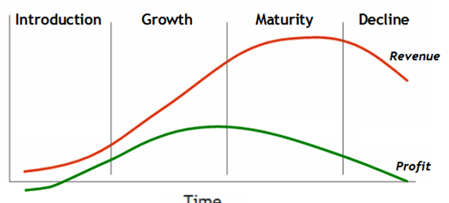
Appendix 1 Sales and Profits over Product Life Cycle
June 2020
September 2020
June 2023
June 2025
Notes:
Yiwen

Slide 21
Appendix 2 Case Background
Background | Situation: Small, privately-owned conglomerate. - potentially easier decision making, don’t need to grant agreements from board of directors New agriculture technology from the recent acquisition Limited knowledge on this technology & no further plans on investing Current state-of-art but would be outdated in three to five years
 | Complication: Recently acquired unfamiliar Precision Farming technology product is part of a niche market and has potential to be a strong positive contributor to the revenue given the growing nature of the precision farming market, however, early market entry is of the essence here to make sure the captured market share is large enough to produce robust revenue stream.
Notes:
Yiwen

Slide 22
Appendix 3 Key Players
Players | Sponsors: Jordan McGill, SVP of Gyrfalcon Ventures Pat Johnson, COO of Gyrfalcon Ventures | “Client’s” Criteria for Quality and Action: This group will expect rigorous analysis, thorough research, and evidence-based recommendations. Assess all contributing factors Research on: Customers(Ability to pay) Support for the technology Crop alignment Ease of doing business)
 | Decision Makers: Connor Tanis (CFO), Taylor Ingram (CMO), and Cameron Swift (CEO)
 | Stakeholders: Manufacturers, customer, the project team, The potential players are defined by: Ability to pay,
Notes:
Yiwen

Slide 23
Appendix 4 Research Bounds
Bounds | “Client’s” Desired Outcomes: Exploit this technology and maximize revenue while minimizing R&D cost Act quickly | Out of Scope: Will not do research on the US and Canadian market Will not focus on the R&D area
 | In scope: This technology is only integrated into drones for agricultural purposes Price assessment for the product For international markets outside the US and Canada
Notes:
Yiwen

Slide 24
Appendix 5 Entry Modes Selection
Mode | Characteristics
Exporting | High cost, low control
Licensing | Low cost, low risk, low control, low control, low returns
Strategic alliances | Shared costs, shared resources, shared risks, problems of integration
Acquisitions | Quick access to new markets, high costs, complex negotiations, problems of merging with domestic operations
New wholly owned subsidiary | Complex, often costly, time consuming, high risk, maximum control potential above-average returns
Notes:
Yiwen

Slide 25
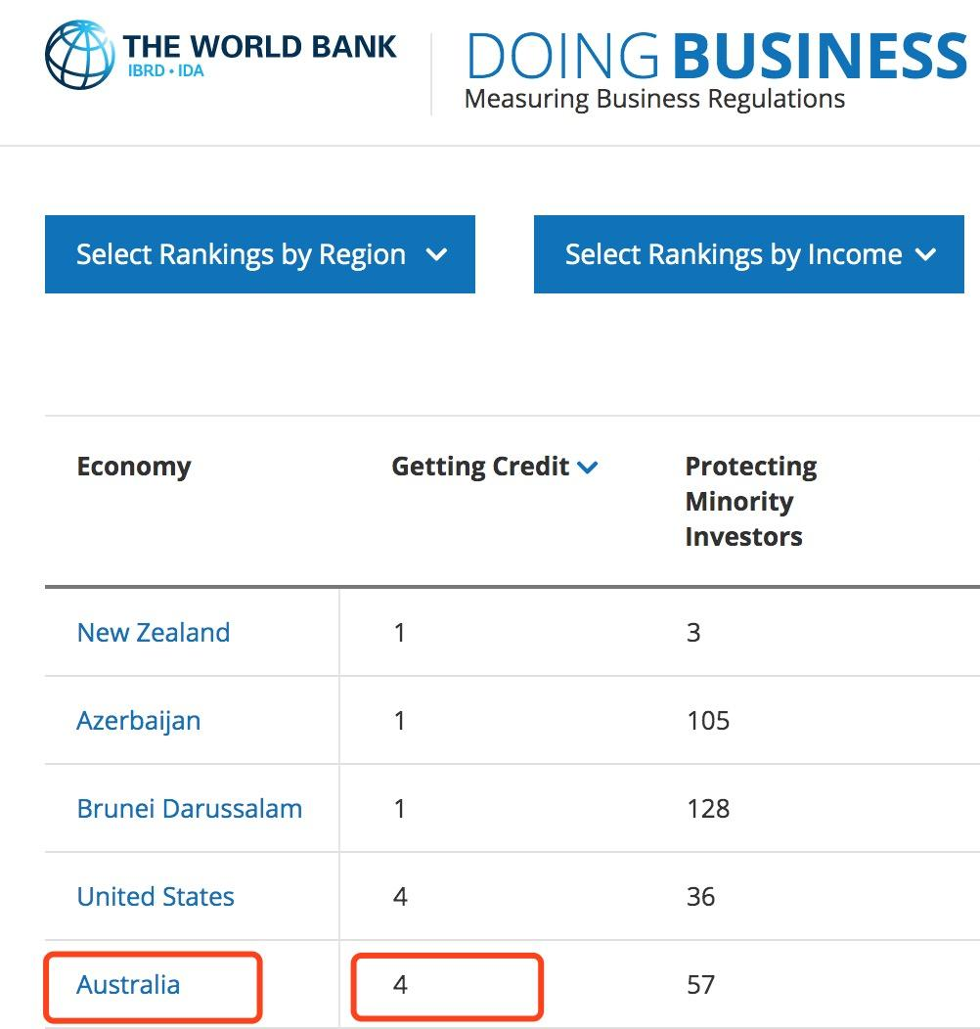
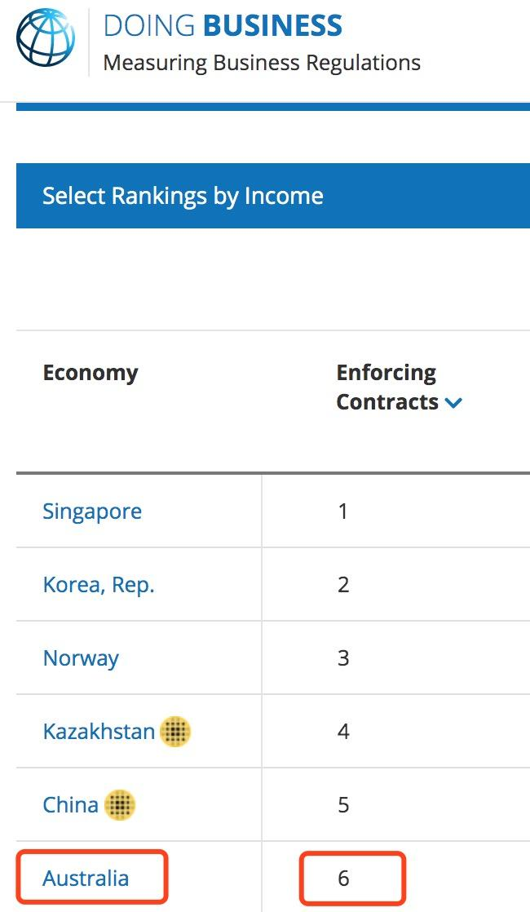
Appendix 6 World Bank Doing Business Ranking
Source: World Bank
https://www.doingbusiness.org/en/rankings#

Slide 26
Appendix 7 Risk & Mitigation
Risk
Mitigation
Selling Concept: We took an inside-out view that focuses on existing products.
Financial assumptions are subject to change.
Emphasize an outside-in perspective: While aiming to sell what the company makes, we also research customer needs and wants.
Work with the finance & accounting team to get specific numbers on Australia.
Notes:
Yiwen

Slide 27
Appendix 8 Global Potential Analysis
Market Drivers (High)
Pressure of exploiting product value in short period of time.
Government Drivers (Medium)
Some countries have strict drone regulations while others don’t.
04
01
03
Cost Drivers (High)
Economy of scale.
Competitive Drivers (High)
Most precision agriculture companies have global businesses.
02
Comment: As three of the four globalization drivers are high, our product has great potential to go international.

Slide 28
Appendix 9 Citation
A. Growing farm size
B. Political, Legal, and Infrastructure
Taylor, J. (2019, July 27). 5G in Australia: getting up to speed with the future of mobile. Retrieved from https://www.theguardian.com/technology/2019/jul/28/5g-in-australia-getting-up-to-speed-with-the-future-of-mobile
Lefroy, T., Key, J., & Kingwell, R. (2017). An examination of broadacre farm size and performance in western australia. The Australian Economic Review, 50(1), 52-65\. doi:http://dx.doi.org/10.1111/1467-8462.12186
Kirchner, Stephen (2012, Dec). Foreign Direct Investment in Australia Following the Australia–US Free Trade Agreement. Retrieved from https://onlinelibrary.wiley.com/doi/epdf/10.1111/j.1467-8462.2012.00686.x

Slide 29
Appendix 9 Citation
D. Drone accessories
E. Precision agriculture in Australia
Bramley, Robert & Trengove, Sam. (2013). Precision agriculture in Australia: present status and recent developments. Engenharia Agrícola. 33. 575-588. 10.1590/S0100-69162013000300014.
https://www.researchgate.net/publication/262706376_Precision_agriculture_in_Australia_present_status_and_recent_developments
C. Wheat water and nutrients
Chen, W., Bell, R. W., Brennan, R. F., Bowden, J. W., Dobermann, A., Rengel, Z., et al. (2009). Key crop nutrient management issues in the Western Australia grains industry: a review. Australian Journal of Soil Research, 47, 1–18.
Best Drones For Agriculture 2020: The Ultimate Buyer's Guide Andrew Nixon - https://bestdroneforthejob.com/drone-buying-guides/agriculture-drone-buyers-guide/

Slide 30
Appendix 9 Citation
F. Australia Drone Regulation
Drones. Civil Aviation Safety Authority. (2020). Retrieved 6 March 2020, from https://www.casa.gov.au/drones.
G. Agricultural Adoption:
Tey, Y. S., & Brindal, M. (2012). Factors influencing the adoption of precision agricultural technologies: A review for policy implications. Precision Agriculture, 13(6), 713-730. doi:http://dx.doi.org/10.1007/s11119-012-9273-6

